Slide 1
Domain Specific Modelling Languages in Bigraphs
Gian Perrone
18 February 2013

Slide 2
Objectives
Convince you that modelling is an important activity
Convince you that bigraphs are a good tool for constructing models and modelling languages
Summarise the contributions of my thesis
This will get a little technical…

Slide 3
Outline
Modelling and Motivation
Bigraphs
Bigraphical Languages
Refinement
Tools and Verification
Modular Construction
Conclusion

Slide 4
Modelling and Motivation
Part 1

Slide 5
Explanation
We construct models to explain or understand artifacts and processes of the world around us

Slide 6
Modelling
A system can be too complex to understand or analyse directly
A model can be a simplification or an abstraction
… or simply a blueprint that can be analysed prior to constructing something larger
Compare: mental models, sketches, blueprints, mathematical models

Slide 7
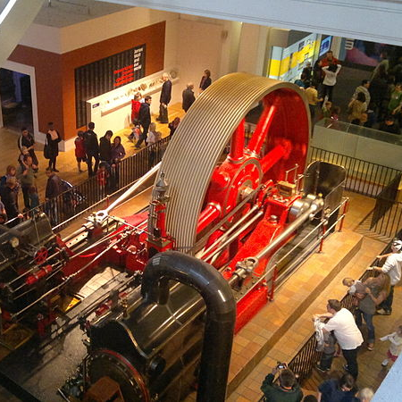
1903 Mill Engine
London Science Museum
Source: Wikimedia Commons

Slide 8
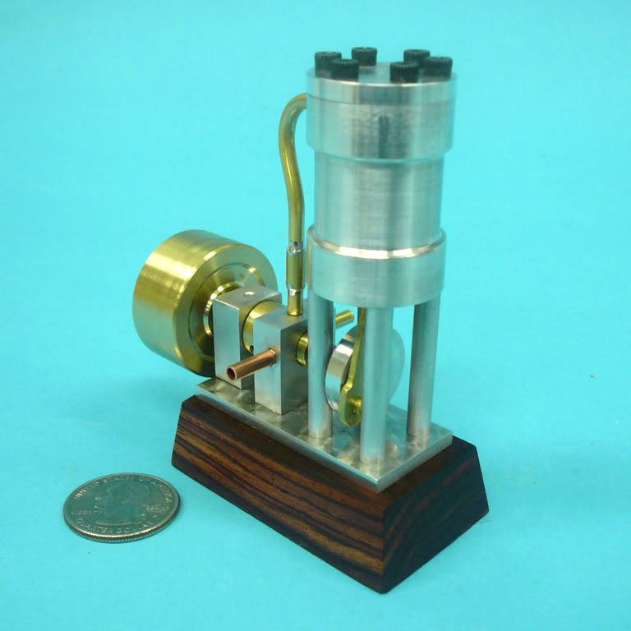
1973 Model Steam Engine
Source: homemodelenginemachinist.com

Slide 9
Simplifying Assumptions
When testing the aerodynamic properties of a plane, it’s not necessary that the seats be comfortable.
A model may ignore or simplify some properties in order to focus attention on the interesting or important properties
Control, approximate, or obscure some factors in order to understand the interplay and functioning of others

Slide 10
Abstract Models
Those are concrete models of concrete things (e.g., planes, steam engines) with obvious modelling techniques
What about abstracted models of entire systems that don’t necessarily have a concrete presence in the world?
Or which only have a partial presence in the world?
e.g, Software, financial systems, social interactions, computer networks, transport systems, context-aware systems

Slide 11
Communicating Systems
Most interesting systems involve communication and interaction
Claim: We struggle to understand communicating systems at scale
Software systems are some of the most complex systems we build today
e.g., a simple banking transaction must communicate with multiple parties.

Slide 12
Communicating Systems
Simplifying assumption: build models that capture only interaction and communication
Claim: We struggle to understand communicating systems at scale
We don’t care why a system communicates, merely that it can communicate in certain ways
Effective way to model software, business processes, systems biology, financial transactions, network protocols, …

Slide 13
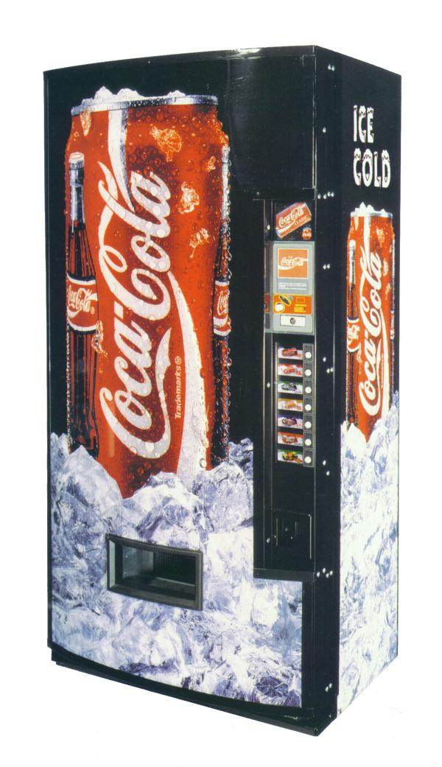
A Vending Machine
Source: Coca-Cola Archive

Slide 14
Another Vending Machine
“A vending machine is a machine which dispenses items such as snacks, beverages, alcohol, cigarettes, lottery tickets, cologne, consumer products and even gold and gems to customers automatically, after the customer inserts currency or credit into the machine.” (Wikipedia)

Slide 15
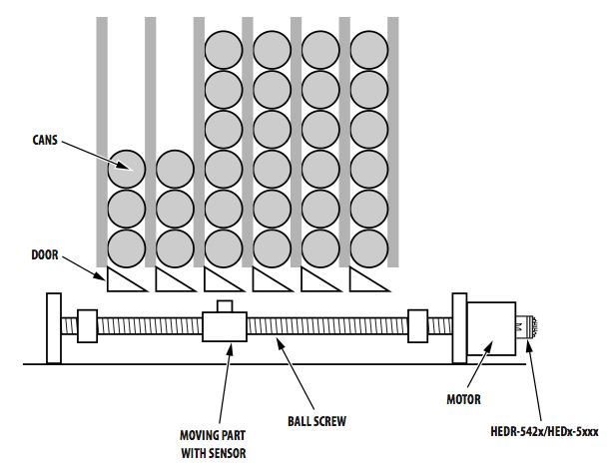
Another Vending Machine
Source: Avago Technologies

Slide 16
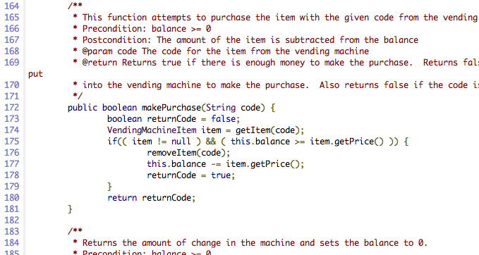
Another Vending Machine

Slide 17
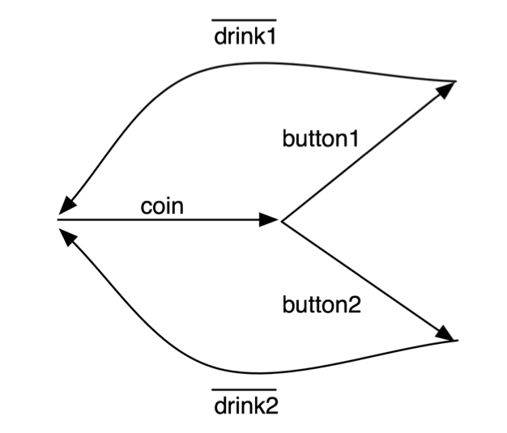
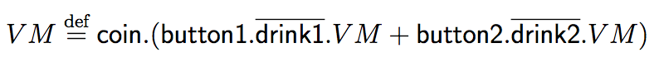
Another Vending Machine

Slide 18
Process Languages
Modelling interaction and communication gives rise to very small process languages (or calculi)
A few common constructs:
Send a message (e.g., push a button, dispense a drink)
Receive a message (e.g., receive a button press, receive a coin)
Choose between different possible actions (choose a drink)
Combine two processes in parallel
Mathematically precise description of behaviour

Slide 19
Process Languages
General purpose (sometimes…)
Structured and precise
Assumes different participants (processes) can reliably and instantaneously send messages to one another using channels
Understand the overall behaviour of many processes behaving together in terms of their individual and composite behaviour

Slide 20
A Buyer

Slide 21
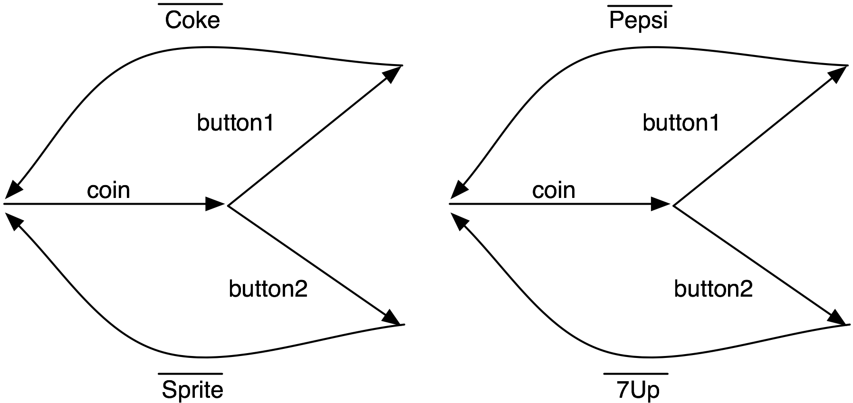
Two Vending Machines

Slide 22
Process Languages
Dozens in common use
Hundreds of variations
e.g., CCS, CSP, ACP, Actor Model, Pi-calculus, Petri nets, cham, Action calculi, …
Endless proliferation of new variations and languages

Slide 23
Proposing a New Process Language
Define syntax and semantics
Prove a handful of interesting properties
Use it once to solve a particular problem
Claim generality
Publish the paper
Forget about it forever
Go to Step 1

Slide 24
Proliferation of Process Languages
New process languages are used to specialise to a given domain
Not cynical – there are good reasons to specialise to a domain!
Instead of trying to stop proliferation of new languages, we should support reuse
… and provide better ways of specialising languages to a given domain
Ephemeral, disposable process languages for every occasion – specialised to a domain.

Slide 25
Domain-Specificity
Moving the language constructs with which we can express models closer to the domain of interest makes models better!
Familiar (natural) language is good!
Domain-experts are not necessarily modelling experts
Instead, describe models in the language of the domain
Business processes in the language of the business
And systems biology in the language of biologists
And security protocols in the language of security experts
The outcome is often of more interest to the domain-expert than the mechanism of the process itself

Slide 26
Domain-Specificity at work
When describing vending machines, we want to talk about drinks and coins and buttons
When a car, we want to talk about wheels and drivers and roads
Domains have different sets of entities they wish to describe
And the meaning of the same entities can change between domains!

Slide 27
Objective
Make it easier to specialise a modelling language to a domain
Promote re-use of components between modelling languages
Make it easier to use modelling languages
… which leads us to…

Slide 28
Bigraphs
Part 2

Slide 29
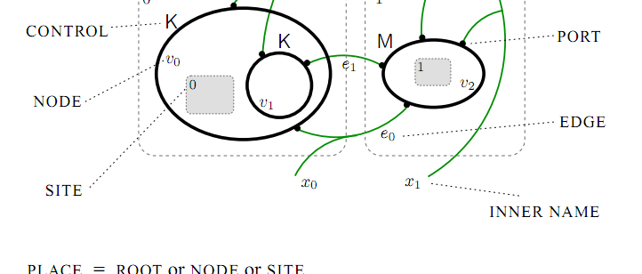
A Bigraph
Source: Milner, R. The Space and Motion of Communicating Agents (2009)

Slide 30
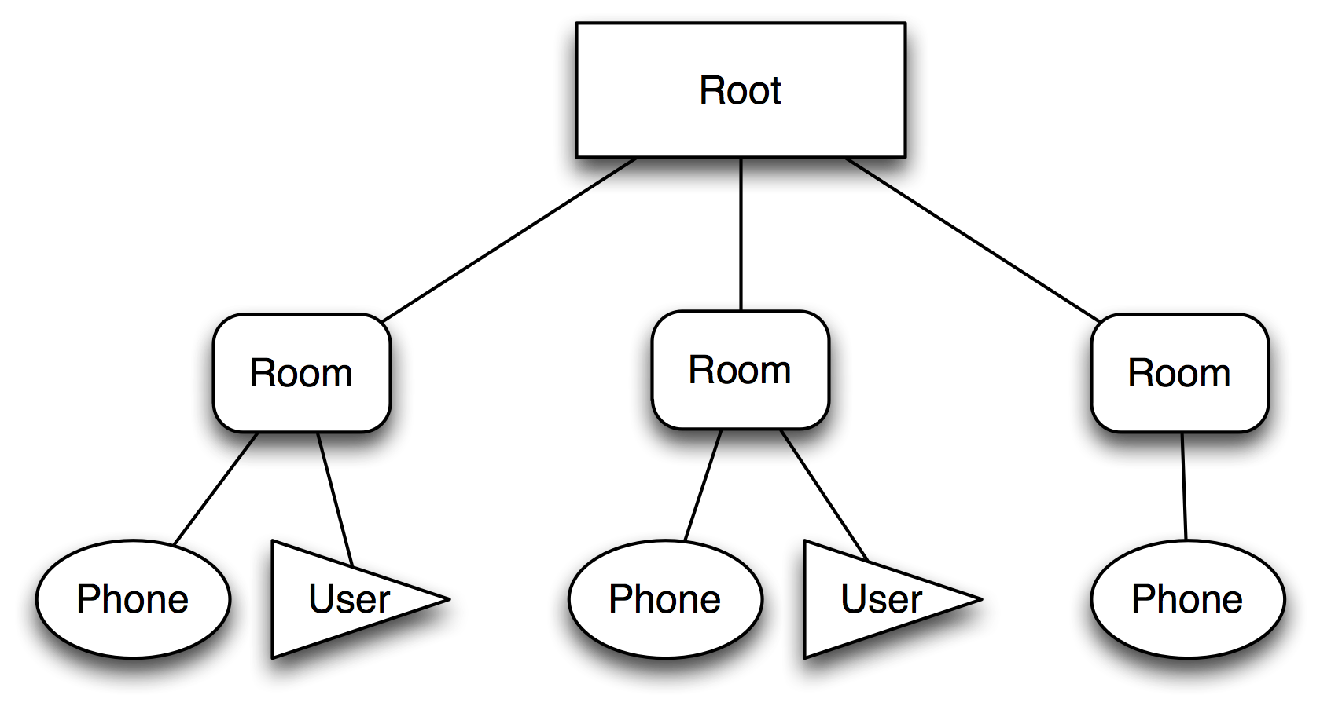
Place Graph

Slide 31
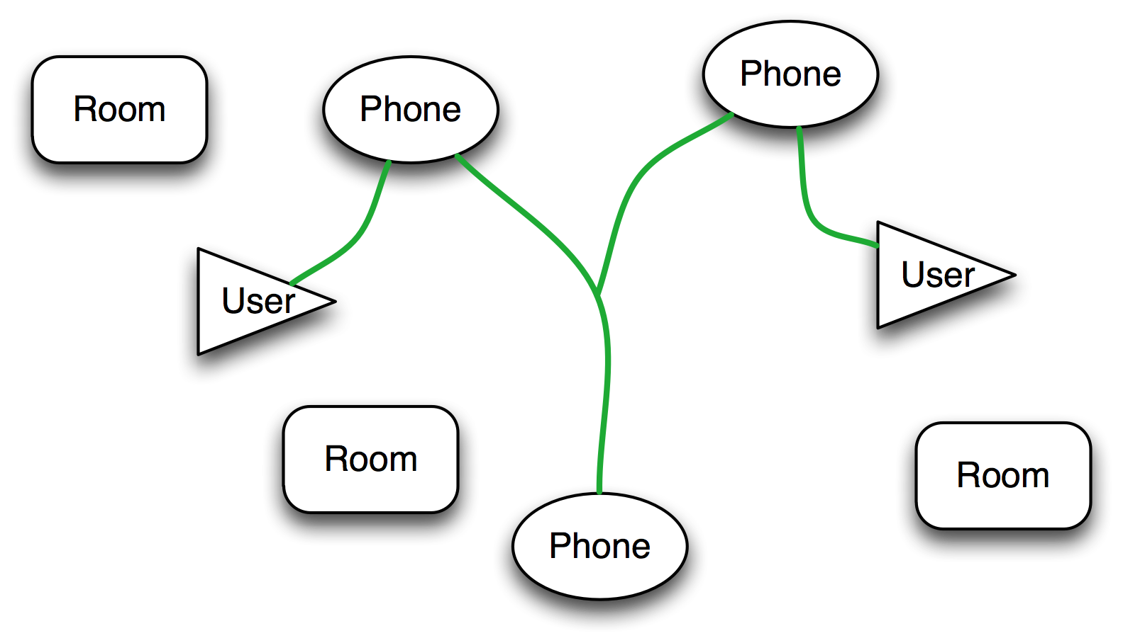
Link Graph

Slide 32
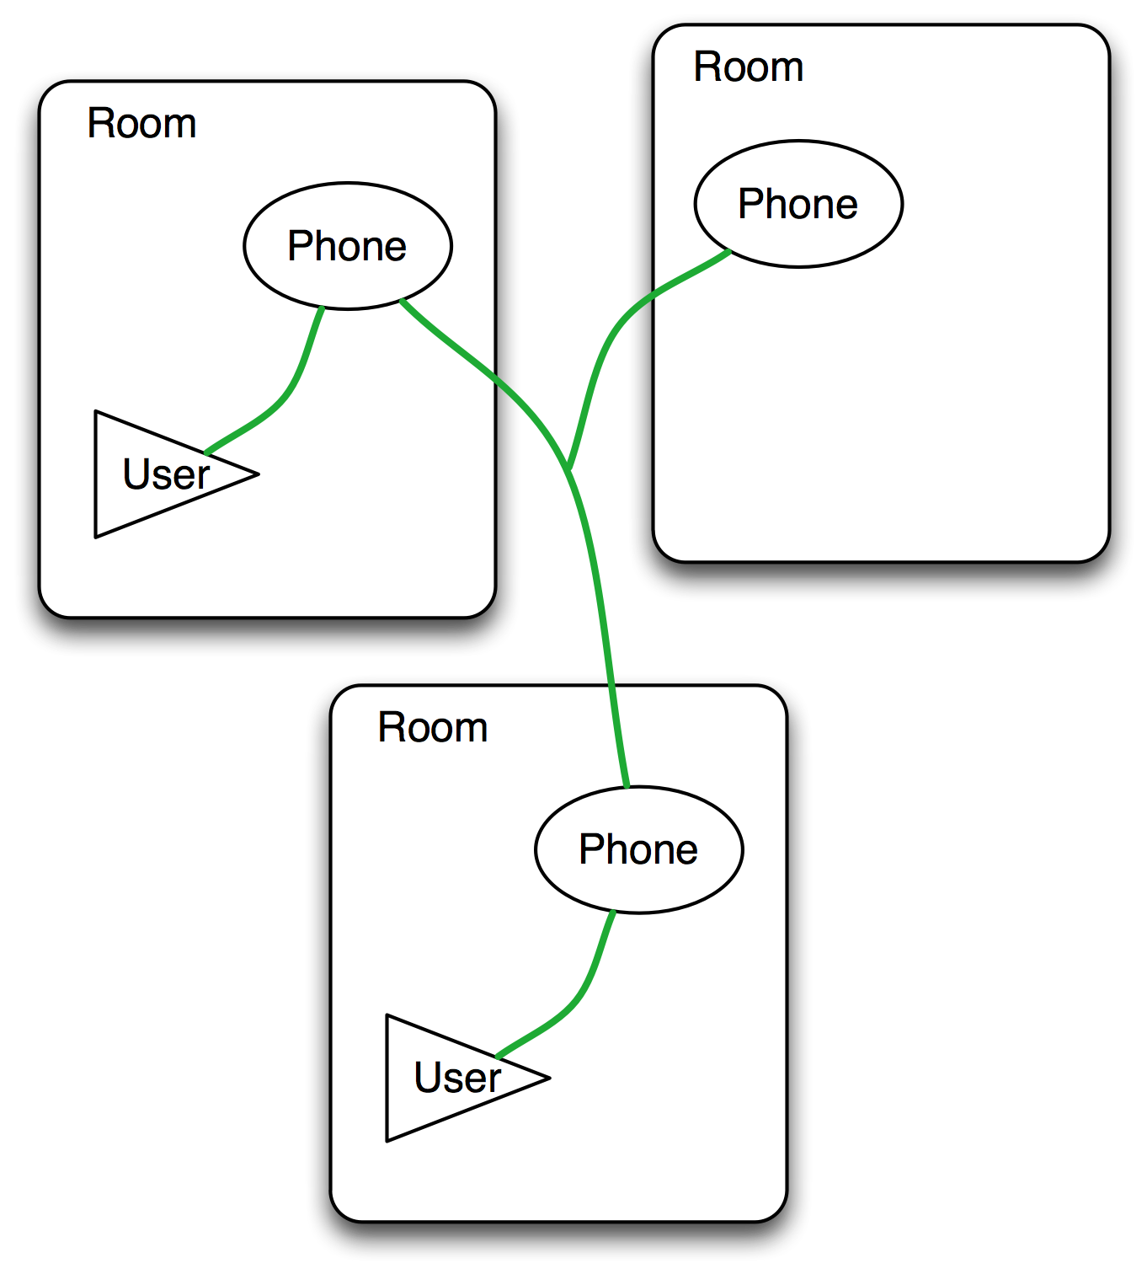
A Bigraph

Slide 33
Bigraphs
Proposed by Milner (2000)
Formal, mathematical objects
Represent orthogonal notions of locality and connectivity
Which are ubiquitous in modelling activities
Locality: physical environments, logical containment, tree structures, filesystems, ownership
Connectivity: association, relationships, networks, name binding

Slide 34
Bigraphs
A bigraph is:
A signature defining a set of controls (e.g., Room, User, Phone)
A place forest, to the nodes of which controls are assigned
A link hypergraph, over the ports of the nodes of the place graph
Capable of encoding many different process calculi

Slide 35
Bigraphs
Unambiguous, formal visual presentation
A categorical presentation in terms of interfaces
Reaction semantics
A single bigraph defines the state of some system
A set of reaction rules describe how the system may behave and evolve over time forming a Bigraphical Reactive System (BRS)

Slide 36
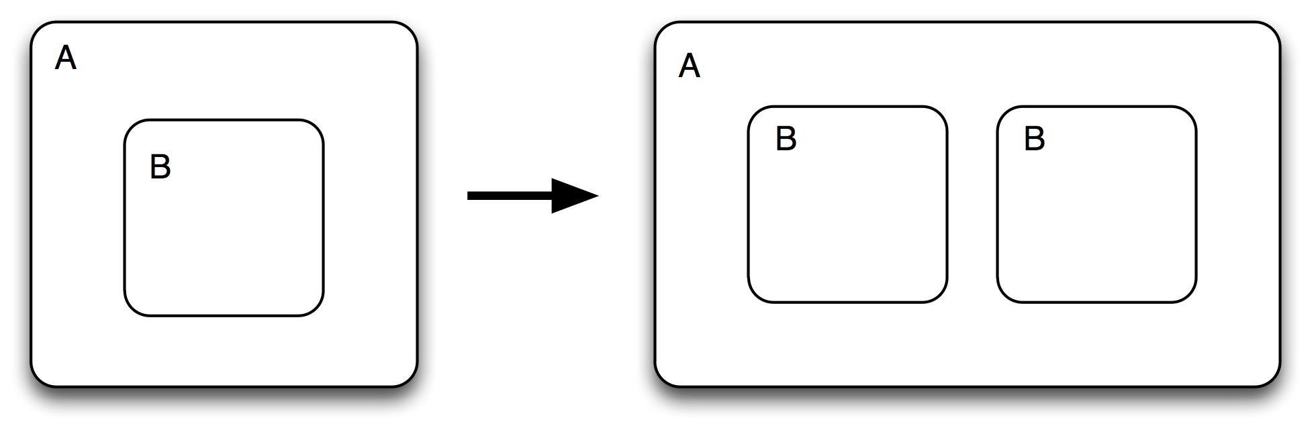
Bigraph Reaction

Slide 37
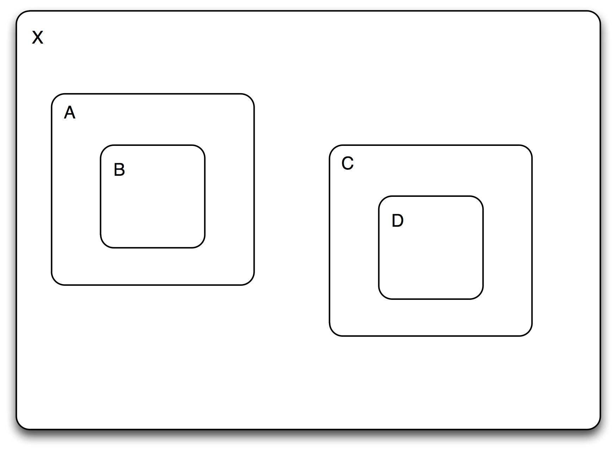
Bigraph Reaction

Slide 38
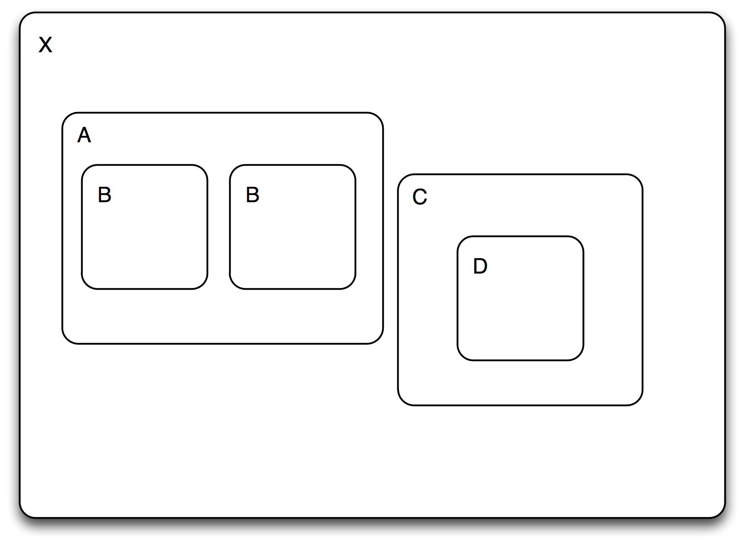
Bigraph Reaction

Slide 39
Bigraphical languages
Part 3

Slide 40
BMC
Presenting bigraphs in a way that is familiar to process calculus experts.
A Bigraphical Meta-calculus
Provides a complete meta-calculus for describing bigraphs
And a sorting logic that guarantees decomposable predicates

Slide 41
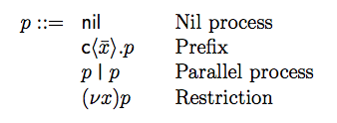
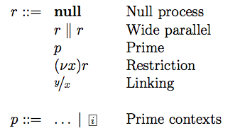
BMC Grammar

Slide 42
BMC Grammar
Translates to bigraphs with interfaces!

Slide 43
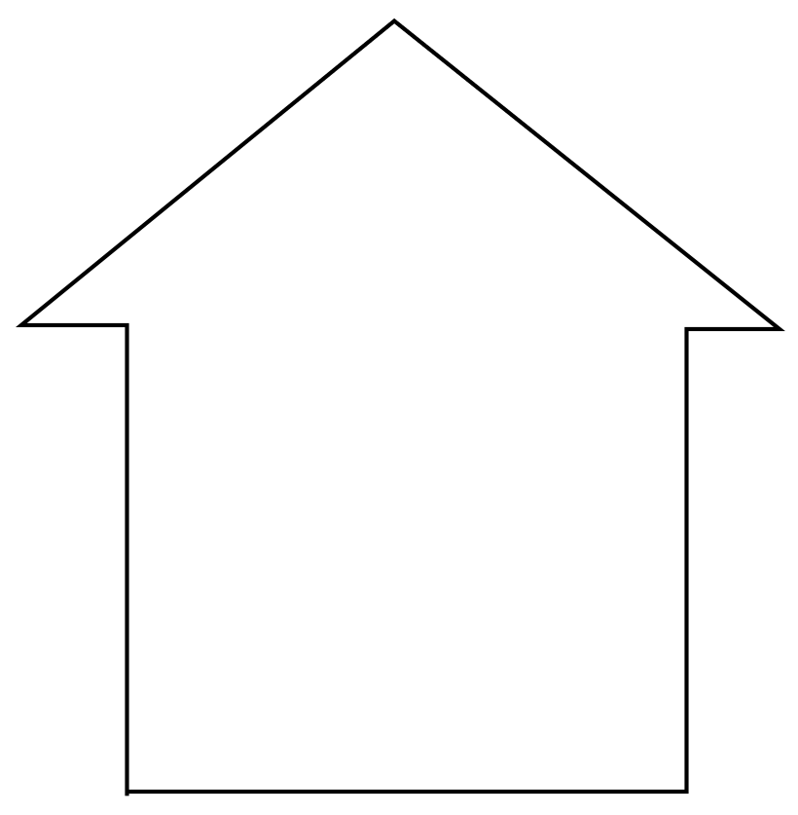

Signatures admit too many agents
A signature gives rise to all possible agents with that signature: e.g.,Σ={ House, Car, Person }
House.Person

Slide 44
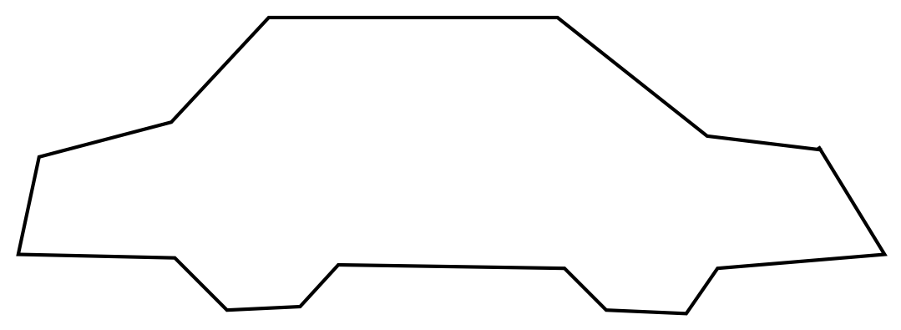
Signatures admit too many agents
A signature gives rise to all possible agents with that signature: e.g.,Σ={ House, Car, Person }
House.Person
Car.Person

Slide 45
Signatures admit too many agents
A signature gives rise to all possible agents with that signature: e.g.,Σ={ House, Car, Person }
House.Person
Car.Person
House.(Person | Person)

Slide 46
Signatures admit too many agents
A signature gives rise to all possible agents with that signature: e.g.,Σ={ House, Car, Person }
House.Person
Car.Person
House.(Person | Person)
Person.Car

Slide 47
Signatures admit too many agents
A signature gives rise to all possible agents with that signature: e.g.,Σ={ House, Car, Person }
House.Person
Car.Person
House.(Person | Person)
Person.Car
Car.Car.(House | House)

Slide 48
Signatures admit too many agents
A signature gives rise to all possible agents with that signature: e.g.,Σ={ House, Car, Person }
House.Person
Car.Person
House.(Person | Person)
Person.Car
Car.Car.(House | House)

Slide 49
Signatures admit too many agents
A signature gives rise to all possible agents with that signature: e.g.,Σ={ House, Car, Person }
House.Person
Car.Person
House.(Person | Person)
Person.Car
Car.Car.(House | House)
The solution is sortings

Slide 50
Sortings
If there is a person, it is contained within a car or a house
If a house contains something, it is not another house
Not all sorting predicates preserve the nice mathematical properties of bigraphs
But decomposable predicates do (Debois, 2008)
BMC sorting logic guarantees any well-formed formula is a decomposable predicate, and therefore “well-behaved”.

Slide 51
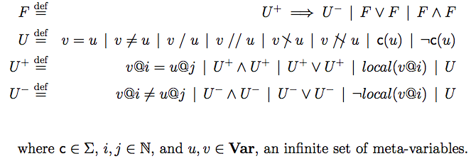
BMC Sorting Logic
Notes:
----- Meeting Notes (18/02/13 00:49) -----
HALF WAY (32 MINS REMAINING)

Slide 52
Sortings
House(u) ∧ u / v ⇒ Person(v) ∨ Car(v)

Slide 53
Defining a language
Syntax: What is the structure of terms of the language?
Given by signature + sorting
Treat bigraphs as generalised abstract syntax trees
Semantics: What do these sentences mean?
Defined by reaction rules
Given a state of a system, what does the system look like after we evaluate one step of an expression?

Slide 54
Bigraphical Languages
Syntax: Signatures + Sortings
What constructors and values are available?
How may these be combined to form valid expressions?
How may names interact and be shared?
Semantics: Reaction rules
Captures exactly the properties we need to define a language

Slide 55
BAM
A Bigraphical Abstract Machine helps us to systematically characterise the execution of bigraphical languages
Considerations:
Find all embeddings first (i.e., matches)
Pick which matches to apply according to an execution strategy
Any maximal strategy gives rise to a fair execution

Slide 56
Refinement
Part 4
Notes:
LESS THAN 30 MINUTES

Slide 57
Equivalence
Refinement is a ubiquitous activity in software engineering
Given a high-level specification, move towards an eventual implementation
Preserving behaviour and properties of interest at every step

Slide 58
Vertical Refinement
Given a language L1, and a model M constructed in that language…
I want to extend L1 with more detail or a different perspective, obtaining language L2
Does it still capture the properties of interest?
Does it exhibit any extra, undesirable behaviour in this new setting?
This is captured by enforcing a vertical refinement relation between the languages L1 and L2

Slide 59
Observation
Reeves and Streader (2008) use notions of what we can observe of all entities of a language to demonstrate vertical refinement
For many process languages, “observation” is obvious (i.e., the inputs and outputs that the process sends and receives)
Bigraphs have no primitive notion of input or output, so we can’t rely on it to construct a useful notion of observation

Slide 60
Observation continued
We use an entire model (bigraph) as a single observation
Many observations, related by steps of reaction form a trace of a process
And all such traces of all processes of a language characterise completely the behaviour present in that language
Which allows us to relate the behaviour of one language to that of another

Slide 61
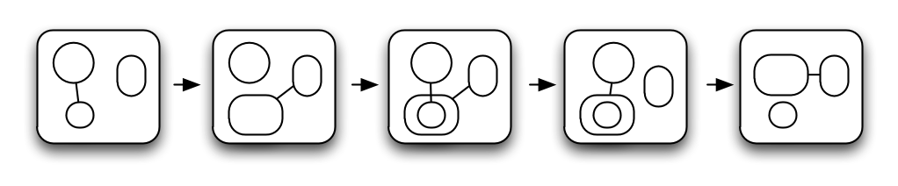
A Trace

Slide 62
A Trace

Slide 63
A Trace

Slide 64
A Trace

Slide 65
A Trace

Slide 66
Safe Vertical Refinement

Slide 67
Safe Vertical Refinement

Slide 68
Safe Vertical Refinement
Abstract
Abstraction Functor
Concrete

Slide 69
Safe Vertical Refinement
Abstract
Abstraction Functor
Concrete
Vertical Refinement

Slide 70
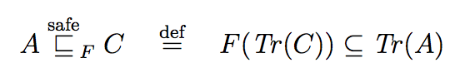
Safe Vertical Bigraphical Refinement
Safety: “Nothing bad will happen”
For a BRSes A and C, and abstraction functor F : C → A
Parameterised by an abstraction functor that allows us to pick the appropriate observations for the task at hand

Slide 71
Making it easier to use
The guarantee that our abstraction functor preserves behaviour (reaction) need not be simple to establish
But if it preserves reaction rules and active contexts, we have an abstraction functor that will give rise to a safe vertical refinement
Which guarantees the concrete system is a valid implementation of the abstract system
This has found use in the work of others (e.g., Henson et al., “FollowMe: a bigraphical approach”, 2012).

Slide 72
Live Vertical Refinement
Liveness is more subtle, and often ignored in refinement literature (or considered a special case of safety)
Essentially the guarantee that “something good will happen eventually” (Lamport)
Our vertical refinement notion can also ensure that a concrete implementation preserves enough behaviour from the abstract system to guarantee liveness

Slide 73
Verification and Tools
Part 5

Slide 74
BigMC
Provide a tool that allows one to check properties of bigraphical models
By defining a single bigraphical language, we gain a tool for any model expressed in that language
BigMC was a prototype tool designed to achieve this
Also has been used to simulate and experiment with bigraphs

Slide 75
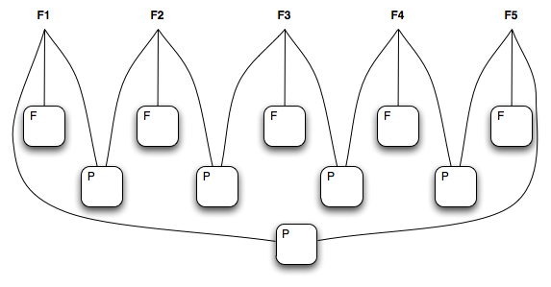
Example: Dining philosophers

Slide 76
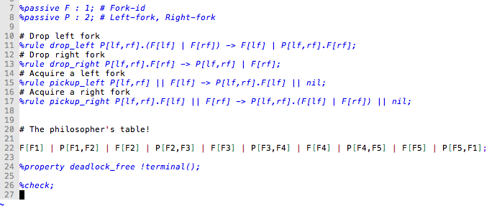
Dining Philosophers

Slide 77
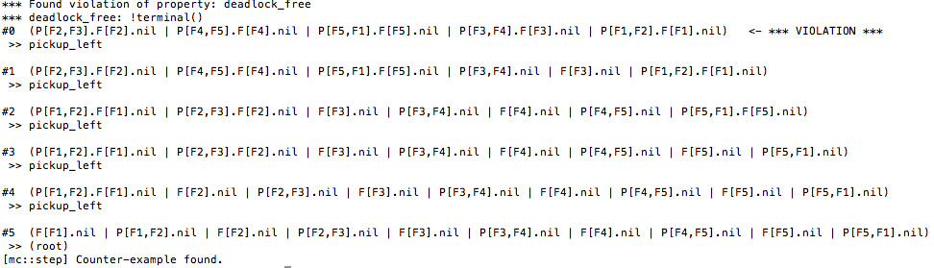
BigMC Output

Slide 78
The state explosion problem
Potentially infinitely many distinct states to explore
… which will run forever if we just try to check them
What can we do better? Attempt to use the semantic clues provided by the system designer in defining reaction rules
Approximate (conservatively) the causation relation between reaction rules, groups of reaction rules, and the properties of interest
Attempt to address the question: which of these rules could cause us to reach a state that would violate our property?

Slide 79
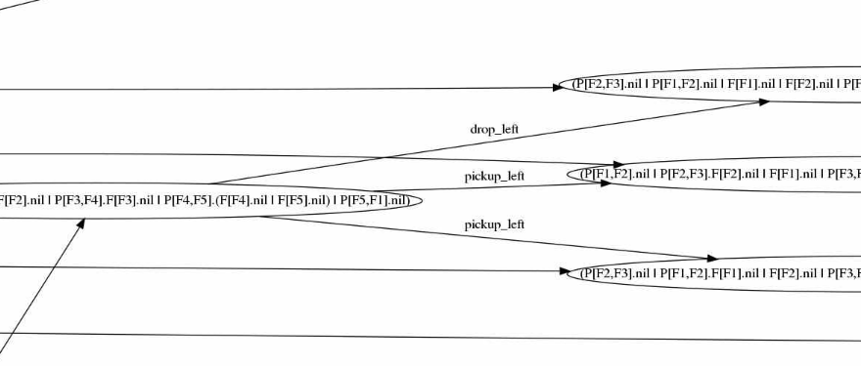
The state explosion problem

Slide 80
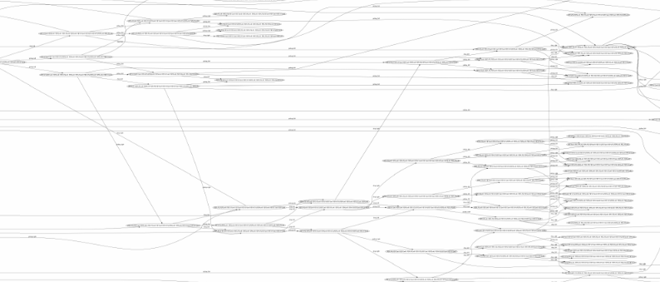
The state explosion problem

Slide 81
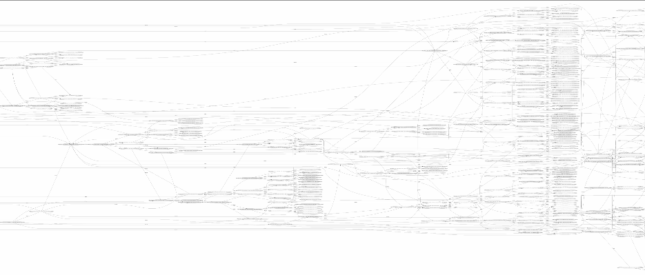
The state explosion problem

Slide 82
Computing Causation
Prior art: Højsgaard & Krivine (2011)
Gives a nice characterisation of how rules may interfere with one another
But not necessarily easy to compute!
We presented a simple heuristic that approximates reaction rule causation for rules obeying a few simple structural conditions
Simple and fast to compute, based on examining the place graph only

Slide 83
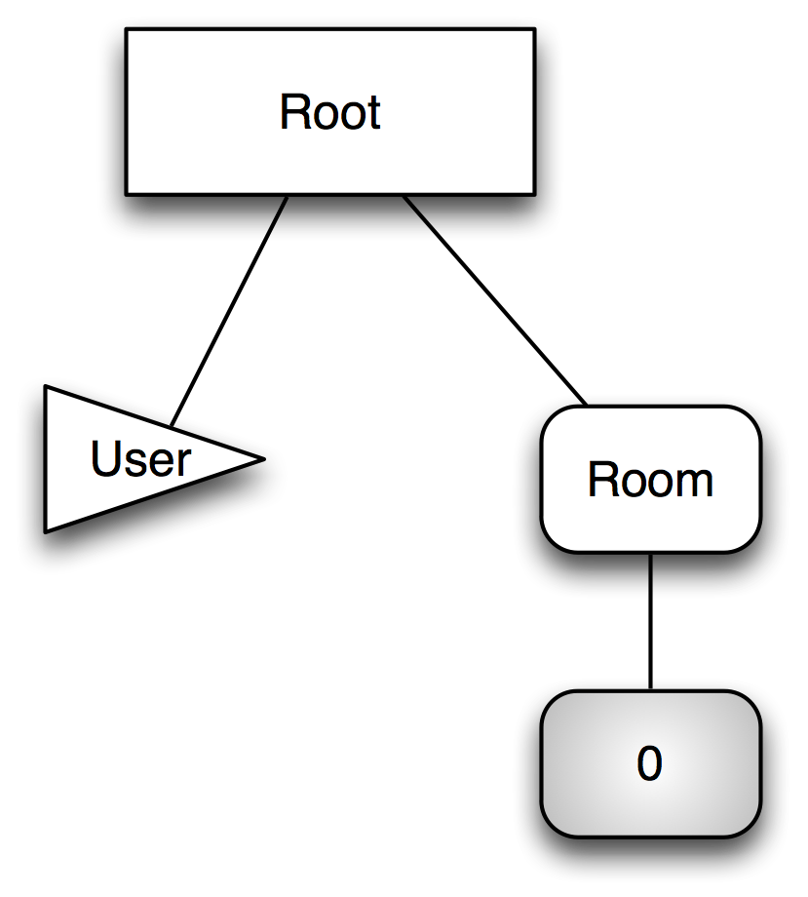
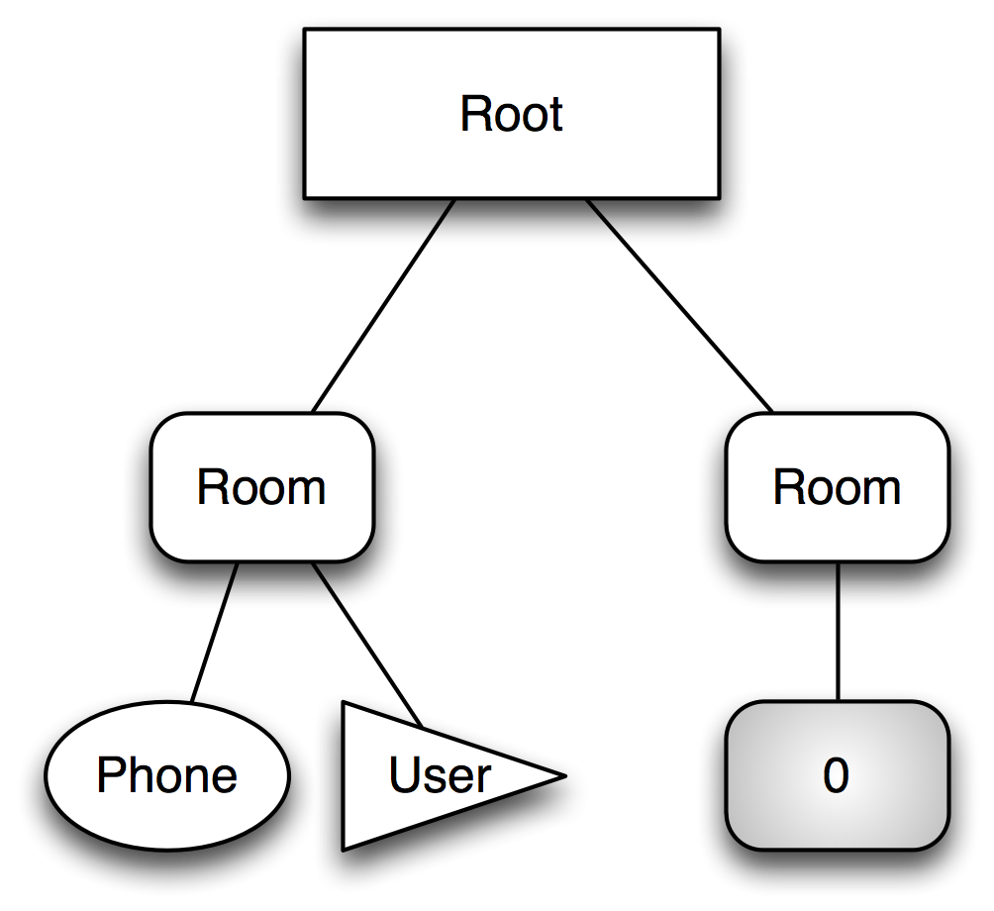
Computing Causation

Slide 84
BigMC
Somewhat crude, but effective at making bigraphs and bigraphical languages more usable
Used by a number of different groups working with bigraphs
Mostly as a way of executing bigraphs, rather than as a model checker
A new generation of bigraphs tools are emerging – a promising trend!

Slide 85
Modularity
Part 6

Slide 86
Modular Construction
Milner’s vision: A tower of (informatic) models
An attempt to “scaffold” the tower by providing a number of primitive operations by which to construct bigger languages from smaller ones
Permit the construct of a “library” of language components
Vertical Refinement “by construction” where inverses exist
Build and describe signatures and bigraphical reactive systems in a uniform manner

Slide 87
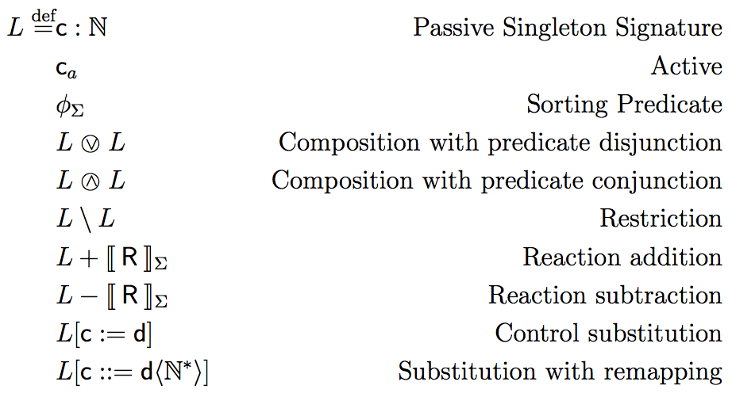
Modular Construction

Slide 88
Considerations
Maintaining consistency (e.g., reaction rules that use controls that have been removed from the signature?)
The existence of inverse operations giving rise to functors
There are multiple ways to combine sortings!
Which gets very subtle – aiming for simplicity and notational convenience
Conjecture: there is a most permissive sorting that provides a safe vertical refinement when combining (sorted) signatures.

Slide 89
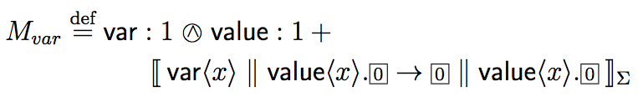
A Language from Components

Slide 90
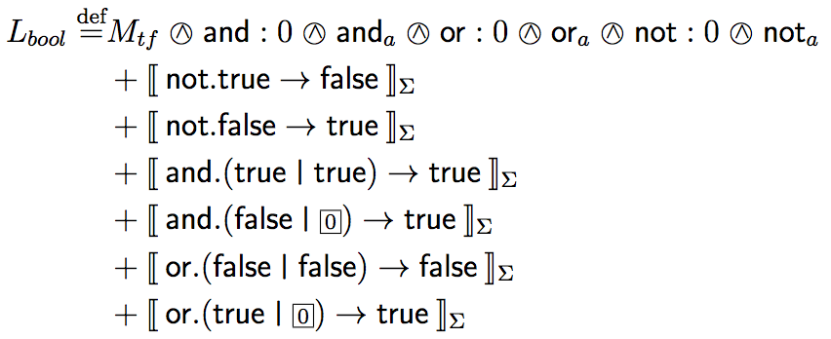
A Language from Components

Slide 91
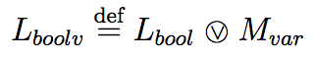
A Language from Components

Slide 92
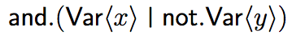
A Language from Components

Slide 93
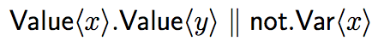
A Language from Components

Slide 94
A Language from Components

Slide 95
A Language from Components
We need a sorting:

Slide 96
Calculational BRSs
This definition of modular construction respects Debois’ conditions for Calculational BRSs – the composition of two unfolding systems is also unfolding
… modulo the definition of activity in bigraphs
Calculational BRSs + modular construction appears a good approach to modelling open systems – e.g., the actor model.
Capture messaging behavioural formally in known process calculi
Capture internal actor behaviour using a calculational BRS

Slide 97
Conclusion
Part 7

Slide 98
Summary
BMC: a convenient representation with which to build bigraphical DSMLs and declarative predicate sortings
BAM: abstracting the problem of finding embeddings from that of applying embeddings, allowing investigation of fairness and execution strategies
Vertical refinement: a usable mechanism for relating bigraphical languages
BigMC: A prototype model checker, with a tractable heuristic for reaction rule causation
Modular construction of BRSs: A start on “scaffolding” Milner’s tower of informatic models

Slide 99
Conclusion
There’s more to do.
But we’re hopefully a little closer…

Slide 100
Future Work
Modular construction and vertical bigraphical refinement in the “Bigraphs Reloaded” setting of Miculan & Peressotti
Generalising activity in bigraphs to unify variations on bigraphs (of which the sorting logic could be a starting point)
A complimentary notion of “horizontal” bigraphical refinement

Slide 101
Thanks
Supervisors:
Thomas Hildebrandt
Søren Debois (until December 2011)
Supported by: The Danish Research Agency (grant no.: 2106-080046) and the IT University of Copenhagen (the Jingling Genies project)

